Slide 1

Jefferson Unitarian Church
Fall 2025 Congregational Meeting

Slide 2
Agenda
Welcome
Chalice lighting
Racial Justice Team: The History of Our Land Update
  8th Principle Survey & Small Groups
The Power of Our Name Update
  Process so Far
  Naming Committee Update & Top Ten Review
  Board Reflections
Next Steps: Timeline & Community Conversations
Turn and Talk
Share Out
Closing - Thank You!

Slide 3
Welcome
Steve DeCaluwe & Melissa Colegrove

Slide 4
Chalice Lighting
Paige LeBlanc

Slide 5
Racial Justice Team Update
Rev. Ruth Rinehart, Mary LeBoeuf & Lucinda Duncan

Slide 6
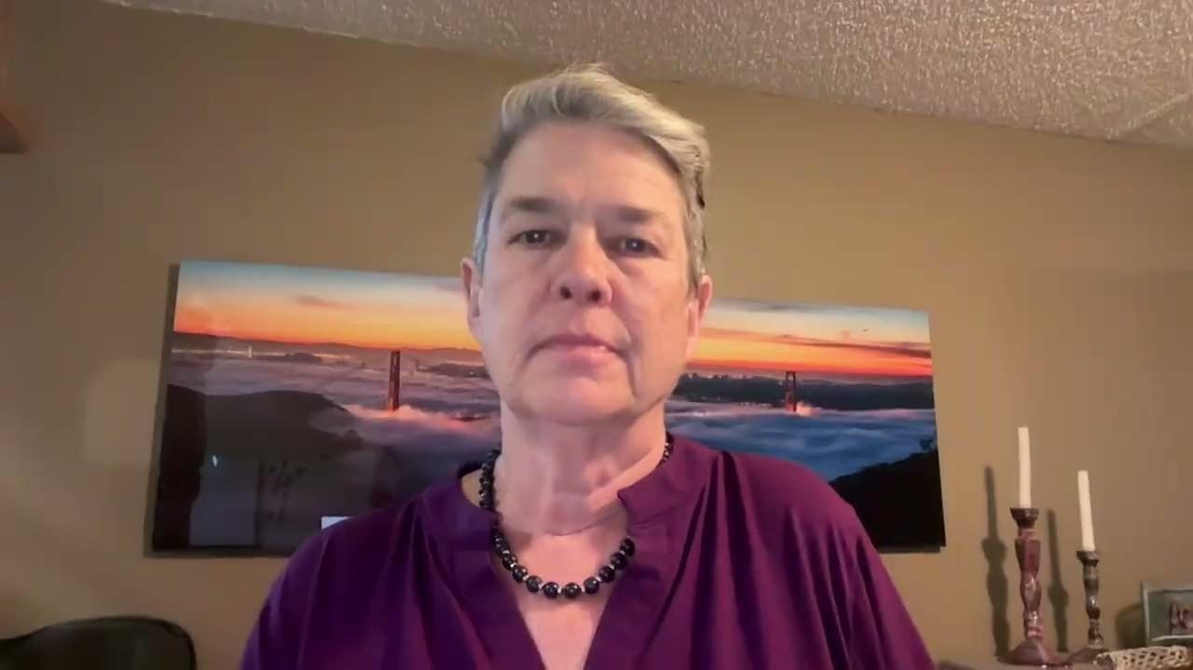
Racial Justice Team Update

Slide 7
Racial Justice Team Update
Mary LeBoeuf & Lucinda Duncan

Slide 8
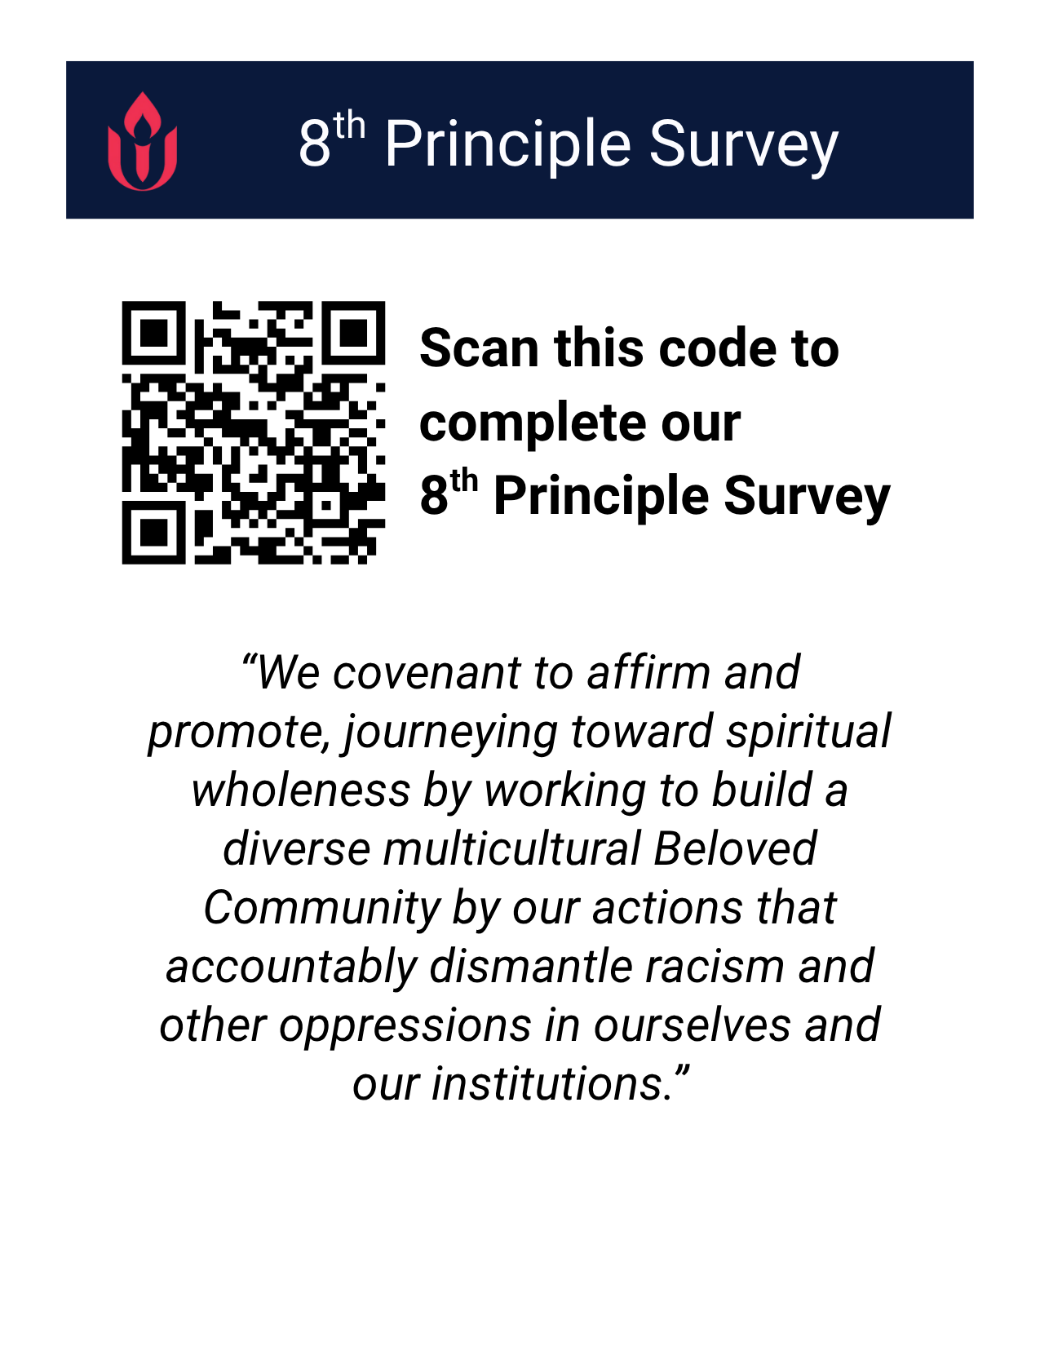
The 8th Principle Survey & Small-Groups
“We covenant to affirm and promote: journeying toward spiritual wholeness by working to build a diverse multicultural Beloved Community by our actions that accountably dismantle racism and other oppressions in ourselves and our institutions.”
An opportunity to sign up for an informational session about our the 8th Principle cohorts that begin in January is provided at the end of the survey!

Slide 9
The Power of Our Name Update
Steve DeCaluwe & Melissa Colegrove

Slide 10
The Power of Our Name Update
The Process So Far
The Vote in May
Name Submissions
Dot Voting

Slide 11
Naming Committee Update & Top Ten
Megan Duncan

Slide 12
Top Ten Names from Dot Voting
What does it take to make JUC “happen” each week?
All Peoples
Beacon
Common Flame
Journey
Mountain Light
Rocky Mountain
Spirit of Life
Table Mountain
Trailhead
Two Mesas

Slide 13
Board Reflections Since Dot Voting
The State of the World
The State of the Board
The State of the Congregation
Notes:
The board has formed an Income Improvement Team. You will be hearing more from us in the coming months.
Did you know?
An average cup of coffee costed $2.83 in 2020 now costs around $3.41 in 2024.
Costs have risen both inside and outside the church and at the same time membership has gone down.
About ¼ of the church increased their pledges.
We want to thank you for all you have done, and you should feel proud of all your hard work.
We have several members who have had to decrease their pledges, our heart goes out to you and we appreciate all you are able to volunteer for our community.
About ½ of the pledging units have stayed flat this year.
Our pitch to you is those who can please consider increasing your pledge, by a small amount now such as a cup of coffee each week.
We will be making this easier in the coming months, with a variety of actions and more communication.
If all the folks who didn’t increase their pledges this past year did by just a small amount we would meet our goals.
New Pledges 31, Increases 127, Flat 240, Decreases 53 out 451 PU.

Slide 14
Next Steps
Laura Andes

Slide 15
Next Steps
Timeline
November ‘25 - January ‘26:
  Community Conversations: Virtual and In-Person
February-March 2026
  Special Congregational Meeting with Vote
March-April 2026
  Reveal Our New Name!

Slide 16
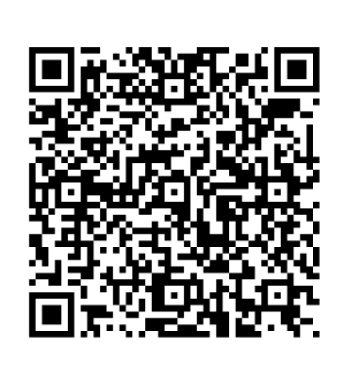
Next Steps
Please Join a Community Conversation:
Thursday November 13, 6:30p - 7:30p
Thursday December 04, 10:00a - 11:00a
Sunday January 11, online, 4:00p - 5:00p
Sunday January 25, 12:30p - 1:30p

Slide 17
Talk and Turn
Paige LeBlanc & Debby Bower

Slide 18
Talk and Turn
All Peoples
Beacon
Common Flame
Journey
Mountain Light
Rocky Mountain
Spirit of Life
Table Mountain
Trailhead
Two Mesas
Choosing a name that you resonate with most:
How do you see this name representing our mission and values?
What message does this name share with those seeking a spiritual home?

Slide 19
Share Out
Derek Basset

Slide 20
Share Out
Please share your reflections with us!
In-person, use a note card to write your thoughts
For viewers at home, please email: bot@jeffersonunitarian.org

Slide 21
Thank You!
Please grab a flyer to take home on your way out
SMT & Naming Committee Members are collecting notecards in the back of the sanctuary
At home viewers, we will send out an email with the provided links and save the dates!

